Slide 1
Getting Robot Positions
By Howard Beck

Slide 2
Math Time
Given the robot’s wheel’s changes in angles, how would we find how much the robot turned?
To answer this, we must consider the robot as a circle, and the left motors are trying to spin it to the right, the right ones to the left.

Slide 3
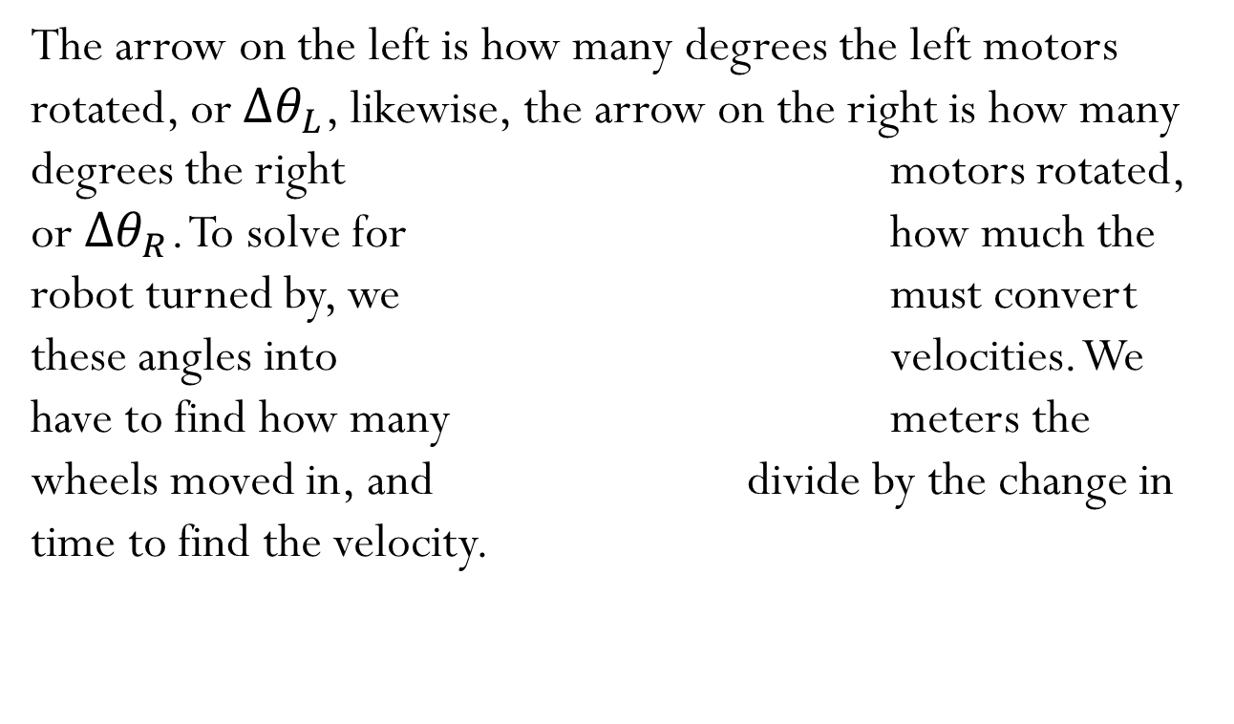
Math Time
The arrow on the left is how many degrees the left motors rotated, or $∆θ_{L}$, likewise, the arrow on the right is how many degrees the right motors rotated, or $∆θ_{R}$. To solve for how much the robot turned by, we must convert these angles into velocities. We have to find how many meters the wheels moved in, and divide by the change in time to find the velocity.

Slide 4
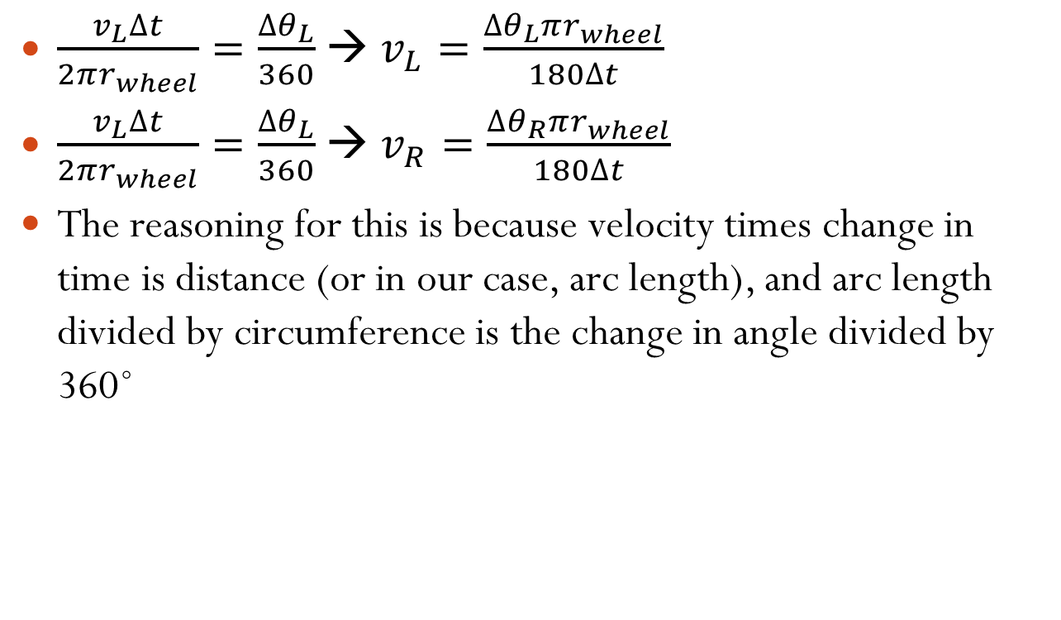
Math Time – Calculating Velocities
$\frac{v_{L}∆t}{2πr_{wheel}}=\frac{∆θ_{L}}{360}$ → $v_{L}=\frac{∆θ_{L}πr_{wheel}}{180∆t}$
$\frac{v_{L}∆t}{2πr_{wheel}}=\frac{∆θ_{L}}{360}$ → $v_{R}=\frac{∆θ_{R}πr_{wheel}}{180∆t}$
The reasoning for this is because velocity times change in time is distance (or in our case, arc length), and arc length divided by circumference is the change in angle divided by 360˚

Slide 5
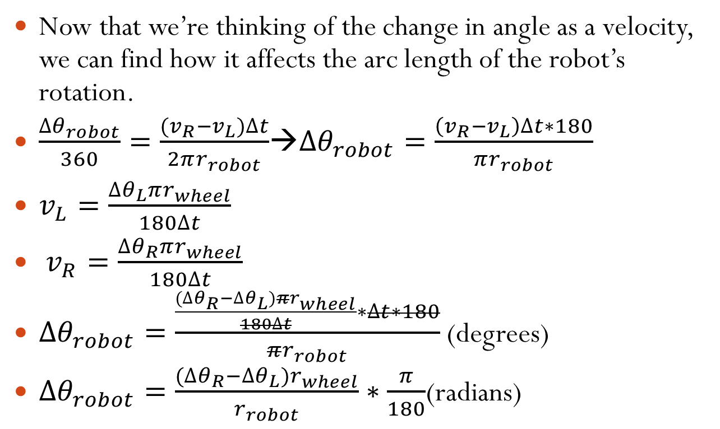
Math Time – Calculating Change in Robot’s Angle
Now that we’re thinking of the change in angle as a velocity, we can find how it affects the arc length of the robot’s rotation.
$\frac{∆θ_{robot}}{360}=\frac{(v_{R}−v_{L})∆t}{2πr_{robot}}$→$∆θ_{robot}=\frac{\left(v_{R}−v_{L}\right)∆t∗180}{πr_{robot}}$
$v_{L}=\frac{∆θ_{L}πr_{wheel}}{180∆t}$
$v_{R}=\frac{∆θ_{R}πr_{wheel}}{180∆t}$
$∆θ_{robot}=\frac{\frac{(∆θ_{R}−∆θ_{L})πr_{wheel}}{180∆t}∗∆t∗180}{πr_{robot}}$ (degrees)
$∆θ_{robot}=\frac{(∆θ_{R}−∆θ_{L})r_{wheel}}{r_{robot}}∗\frac{π}{180}$(radians)

Slide 6
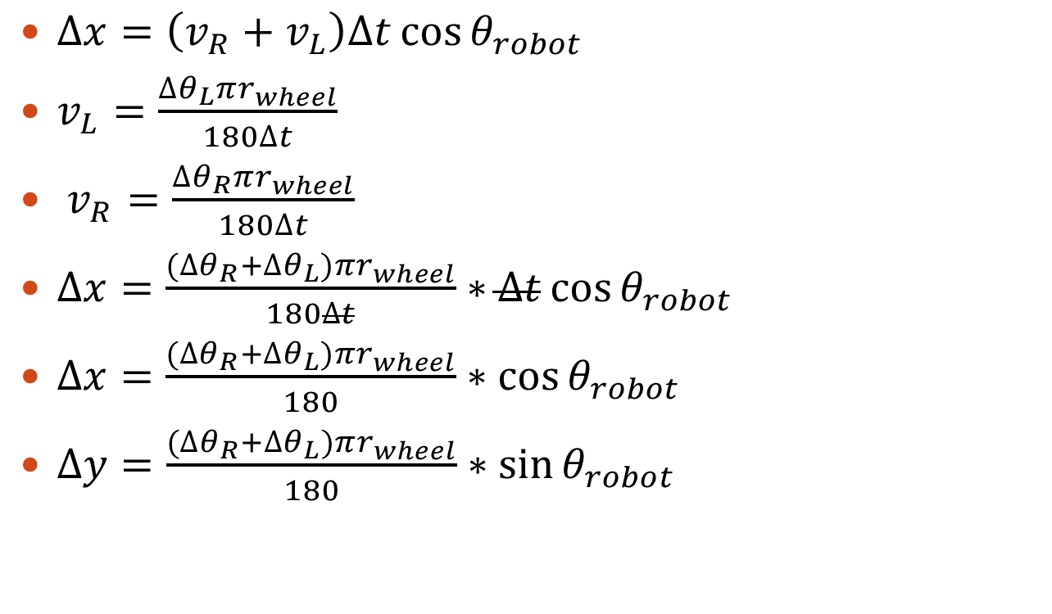
Math Time – Calculating the Robot’s X and Y Positions
$∆x=\left(v_{R}+v_{L}\right)∆t\cos{θ_{robot}}$
$v_{L}=\frac{∆θ_{L}πr_{wheel}}{180∆t}$
$v_{R}=\frac{∆θ_{R}πr_{wheel}}{180∆t}$
$∆x=\frac{(∆θ_{R}+∆θ_{L})πr_{wheel}}{180∆t}∗∆t\cos{θ_{robot}}$
$∆x=\frac{(∆θ_{R}+∆θ_{L})πr_{wheel}}{180}∗\cos{θ_{robot}}$
$∆y=\frac{(∆θ_{R}+∆θ_{L})πr_{wheel}}{180}∗\sin{θ_{robot}}$

Slide 7
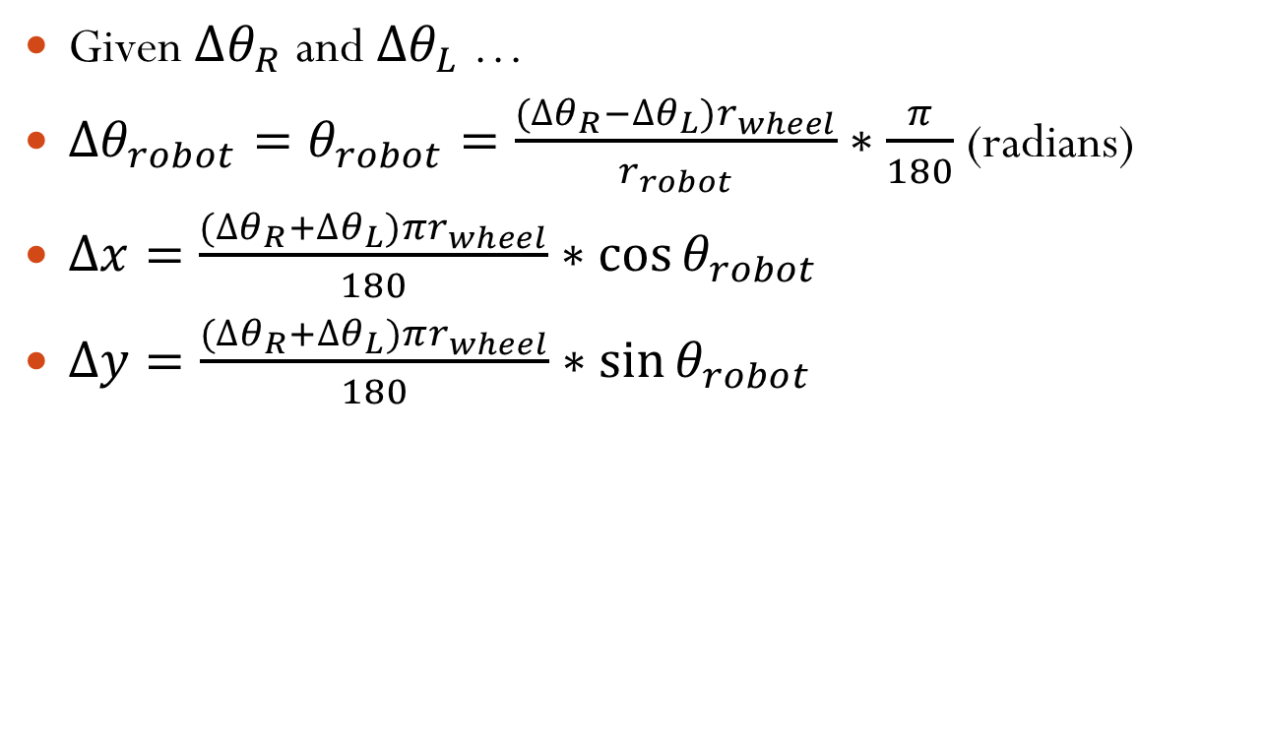
Conclusion
Given $∆θ_{R}$ and$∆θ_{L}$ …
$∆θ_{robot}=θ_{robot}=\frac{(∆θ_{R}−∆θ_{L})r_{wheel}}{r_{robot}}∗\frac{π}{180}$ (radians)
$∆x=\frac{(∆θ_{R}+∆θ_{L})πr_{wheel}}{180}∗\cos{θ_{robot}}$
$∆y=\frac{(∆θ_{R}+∆θ_{L})πr_{wheel}}{180}∗\sin{θ_{robot}}$

